Slide 1
Predicting the Spread of COVID19
DSE 6300: Data Science Application Development
By: Kyle W. Brown, Ishaan Khurana, Jacqueline Connolly, Nishchitha Manjunath, Derick Karolak
4/24/2020

Slide 2



Overview
Background
Data
Pipeline
Models
Visualization
Summary

Slide 3
Data collection/cleaning
John Hopkins daily case/death data for each county in US and each country internationally
Collected predictor data by county (unemployment rate, poverty rate, mortality rates) joined with county case data for regression models

Slide 4
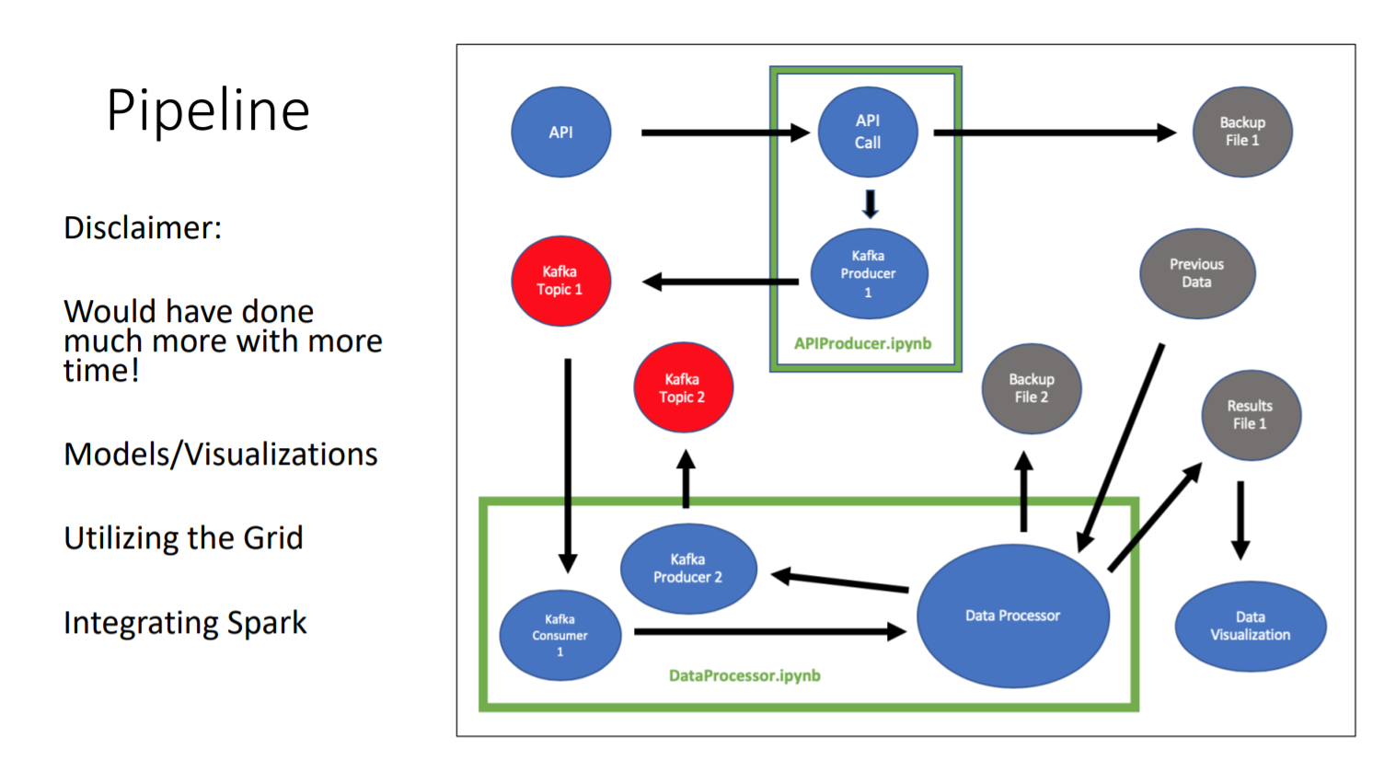
Pipeline
Screenshot of code???

Slide 5
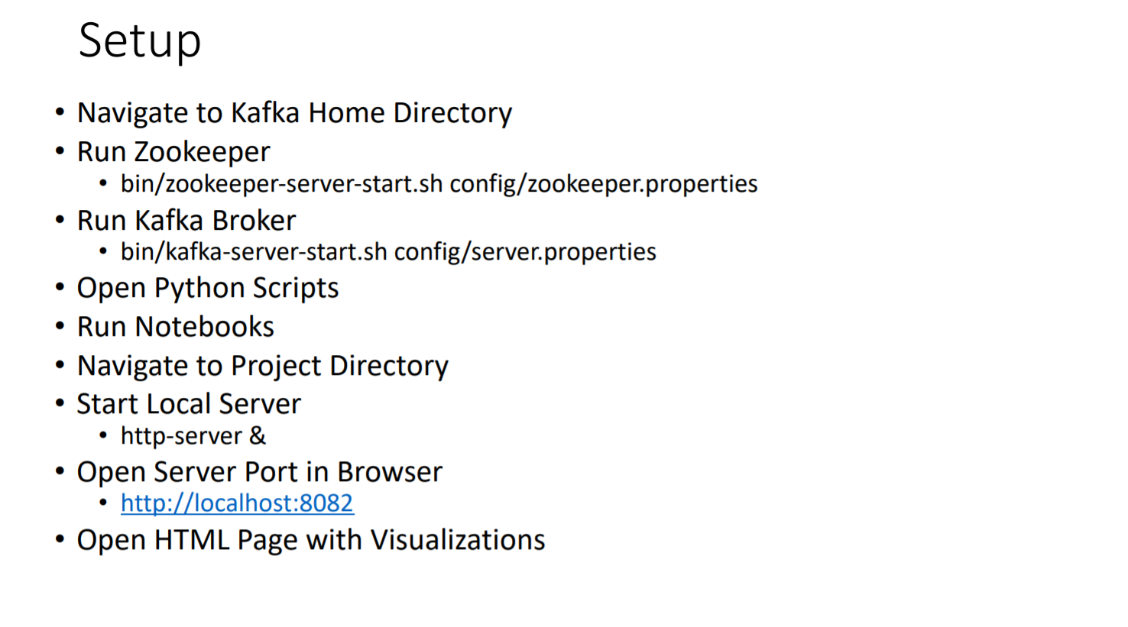

Slide 6
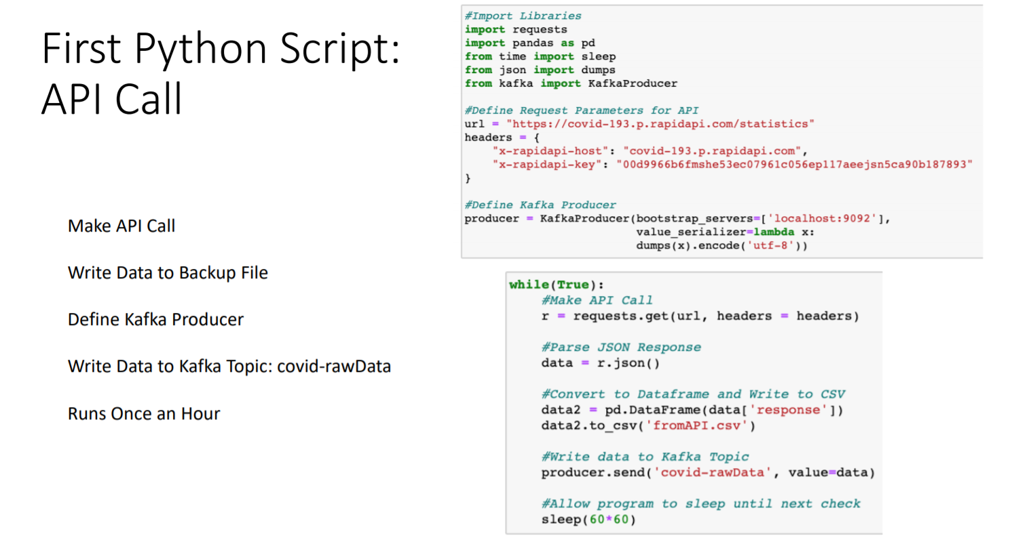

Slide 7
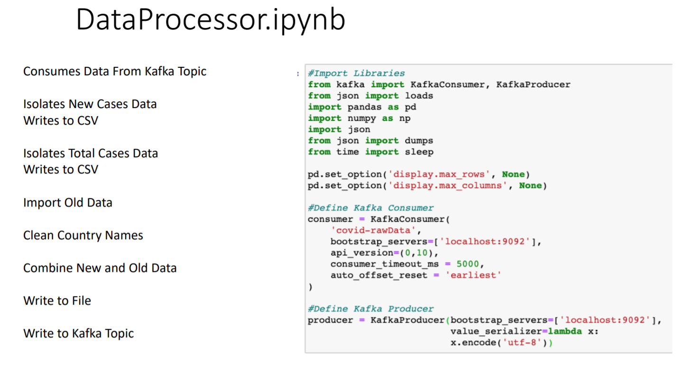

Slide 8
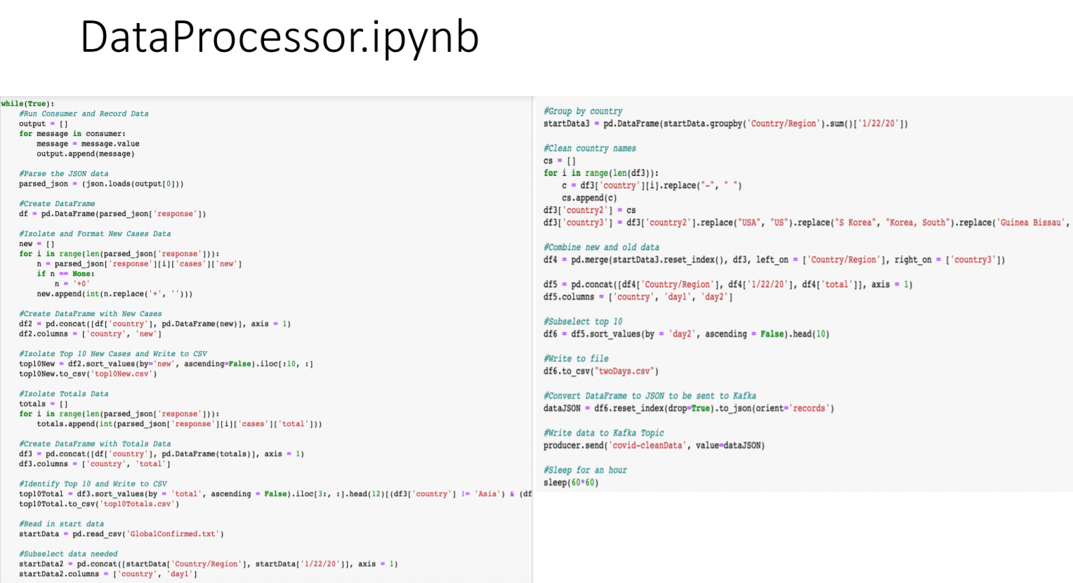

Slide 9
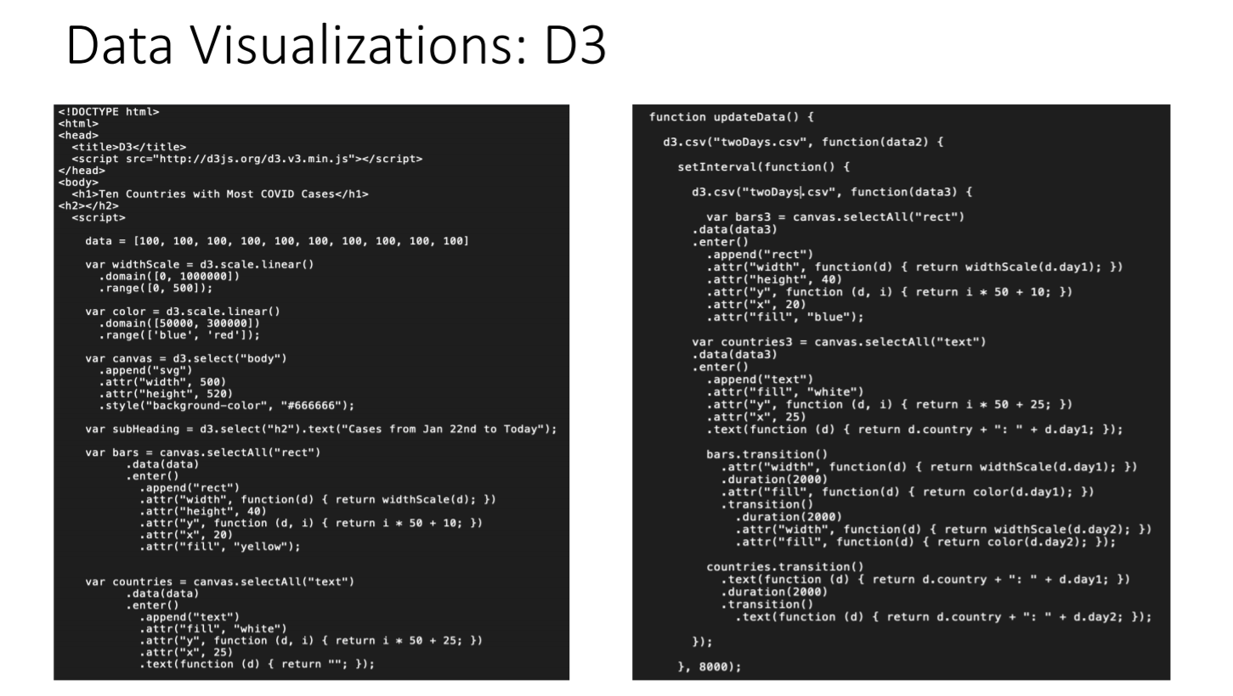

Slide 10
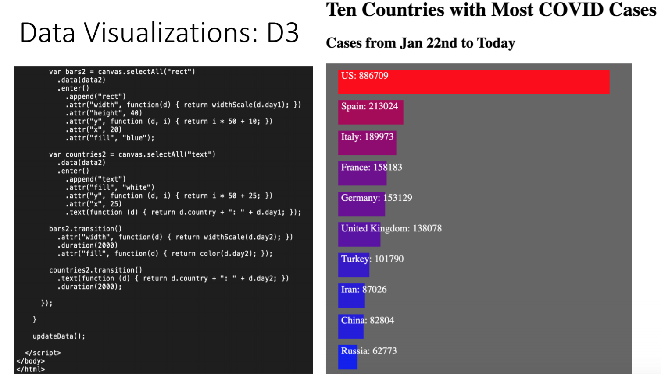

Slide 11
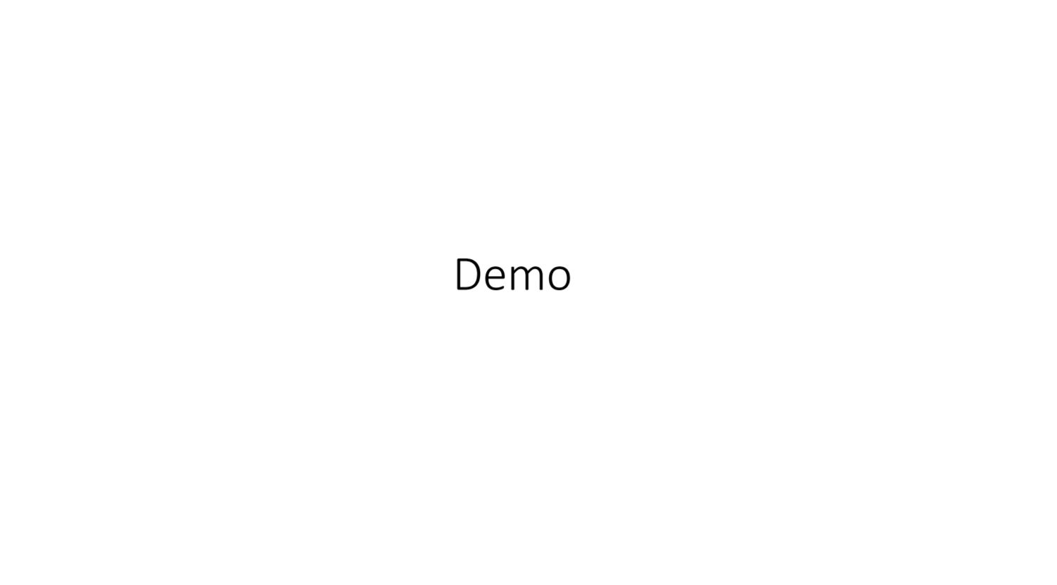

Slide 12
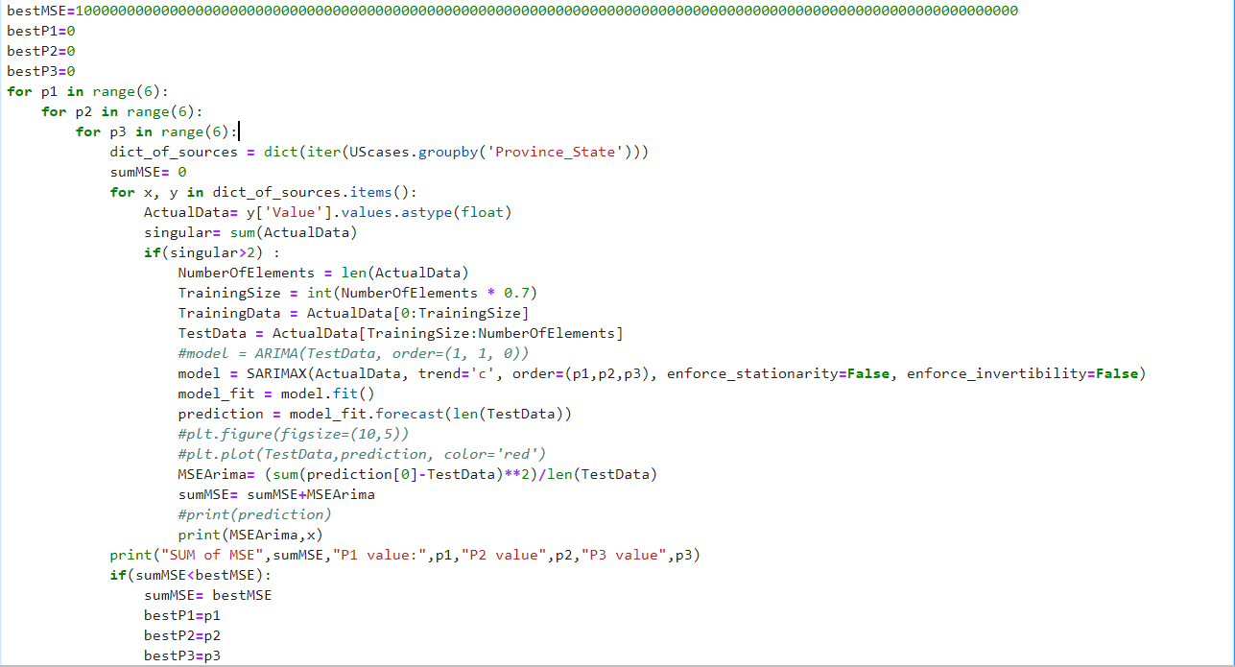
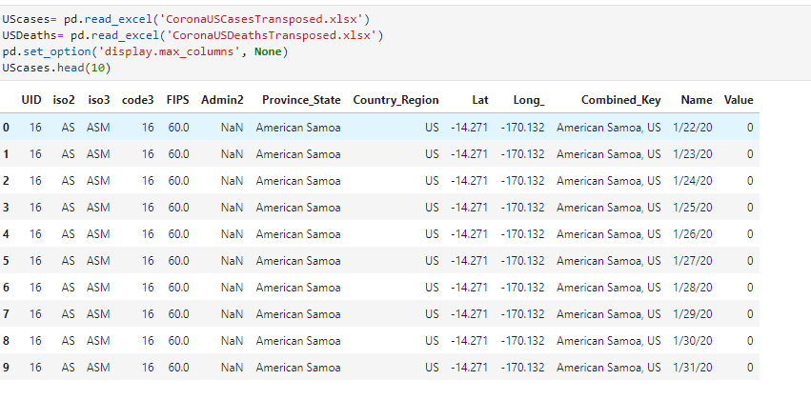
Model Summaries
Python Time series models by each county, country

Slide 13
Model Results
Time series shows a steady increase everywhere through May 1 – Not able to capture when the peak hits for any county in the US or any country
Predictions do not appear accurate for every country, county – unable to select optimal model parameters for each individual dataset (data split by location)

Slide 14
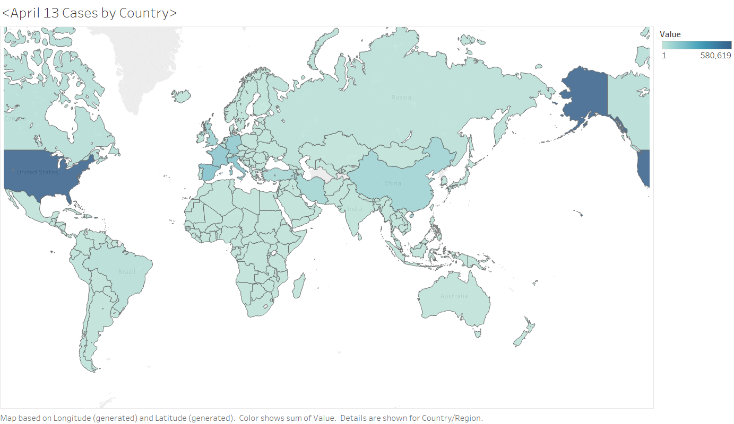
Time series by Country Visuals

Slide 15
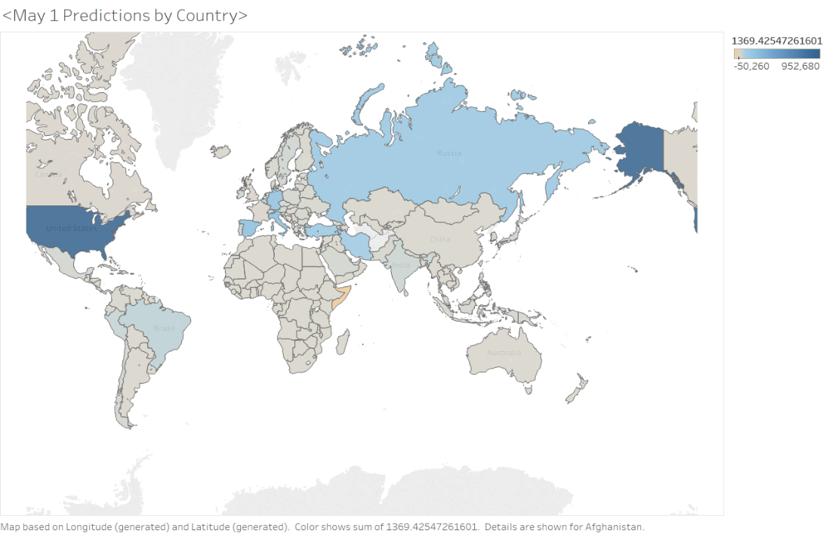

Slide 16
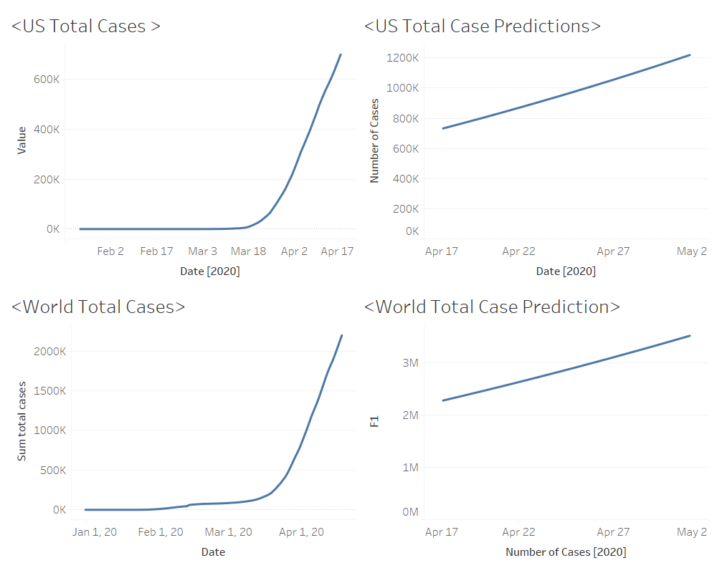

Slide 17
Models
Regressions
Linear
Mulivariate
Non-Linear
Principal Component Analysis
Time Series
AutoML Deep Learning

Slide 18
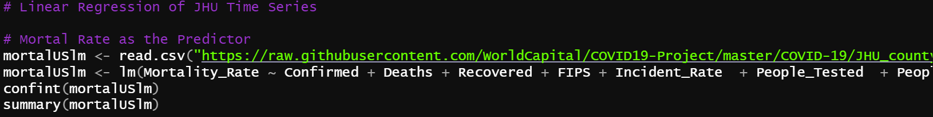
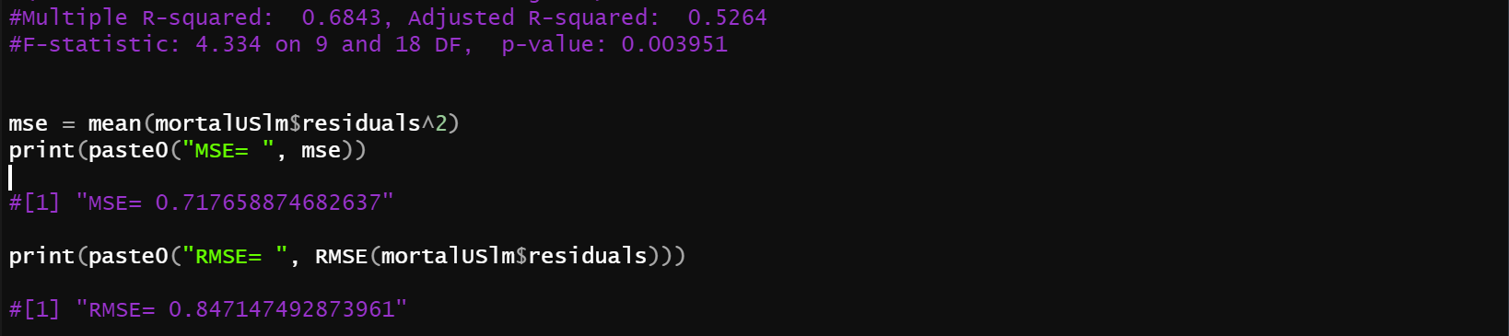
Multivariable Regression

Slide 19
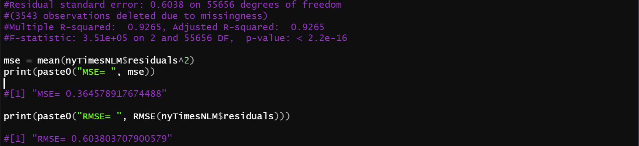
Non-Linear Regressions

Slide 20
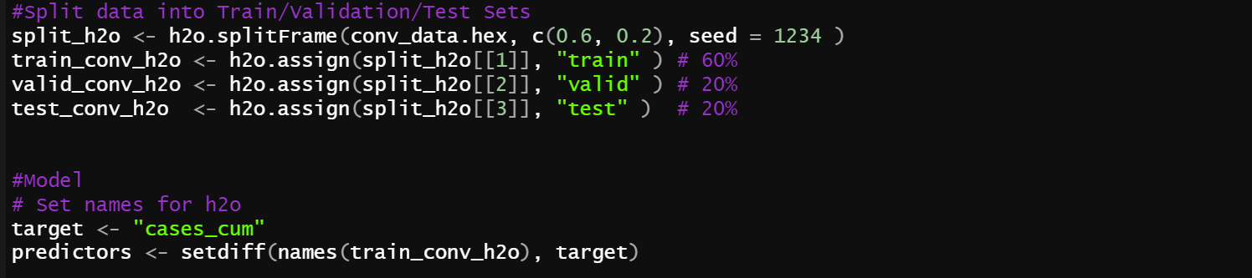
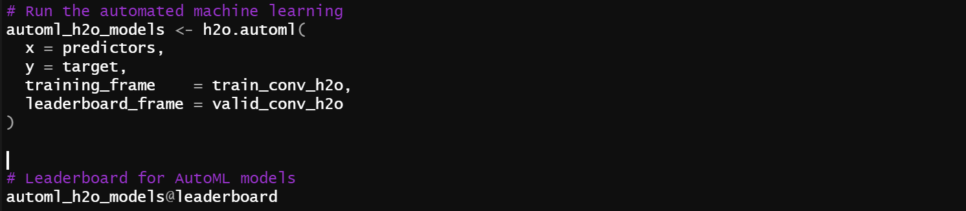
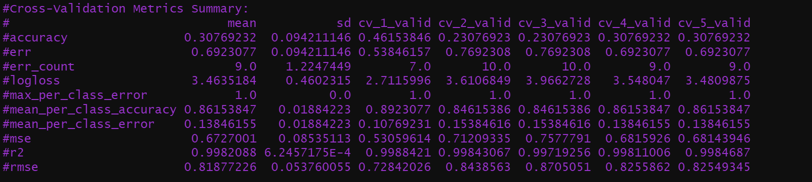
AutoML Models

Slide 21
Model Results
Model | r^2 | rmse | mse
DeepLearning_grid__2_AutoML_20200419_000459_model_6 | 99.80% | 87.24% | 76.10%
GBM_grid__1_AutoML_20200419_000459_model_3 | 99.80% | 84.66% | 71.67%
GBM_grid__1_AutoML_20200419_000459_model_19 | 99.80% | 80.01% | 64.02%
GBM_grid__1_AutoML_20200419_000459_model_11 | 99.80% | 75.51% | 57.02%
GBM_grid__1_AutoML_20200419_000459_model_14 | 99.80% | 75.48% | 56.97%
GBM_grid__1_AutoML_20200419_000459_model_17 | 99.80% | 74.26% | 55.15%
Mortality_Rate_JHU_lm | 52.64% | 71.77% | 84.72%
cases_cum_gbm_AutoML | 99.81% | 67.69% | 82.16%
deaths_cum_gbm_AutoML | 99.76% | 49.60% | 70.25%
Deaths_JHU_nlm | 92.65% | 36.46% | 60.38%

Slide 22
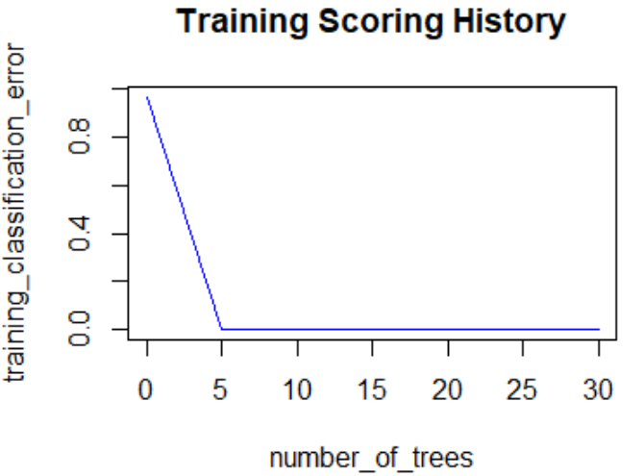
GBM Multinomial AutoML Leader
cases_cum_gbm_model

Slide 23
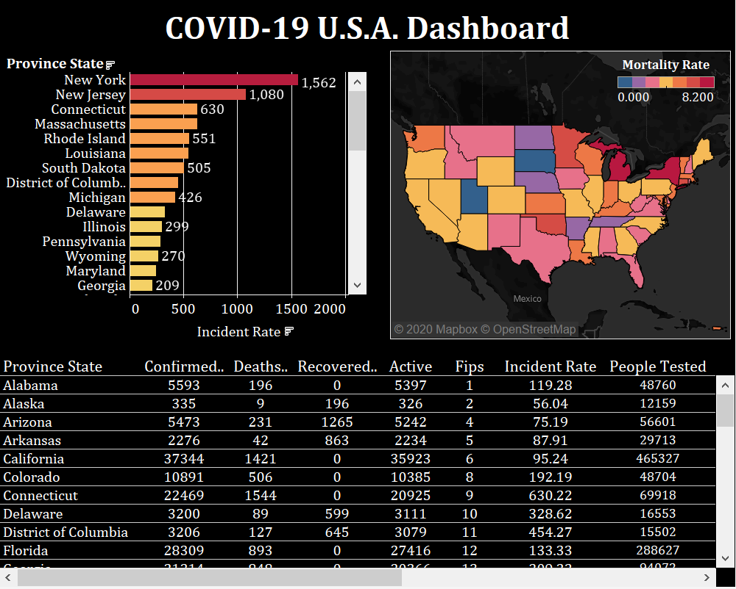

Slide 24
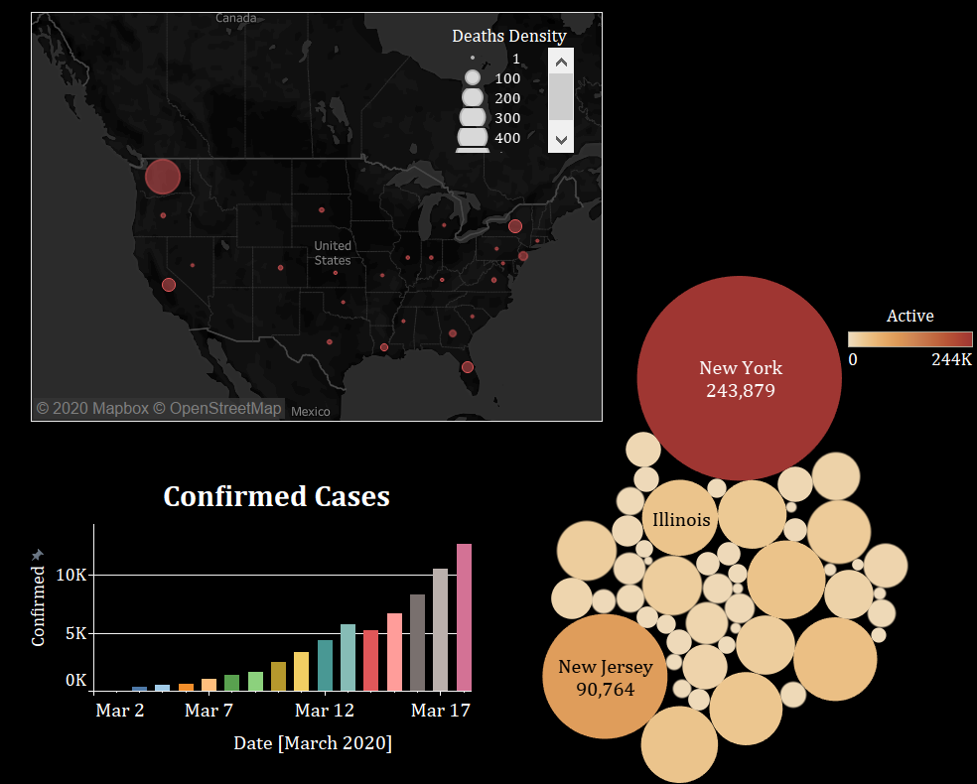

Slide 25
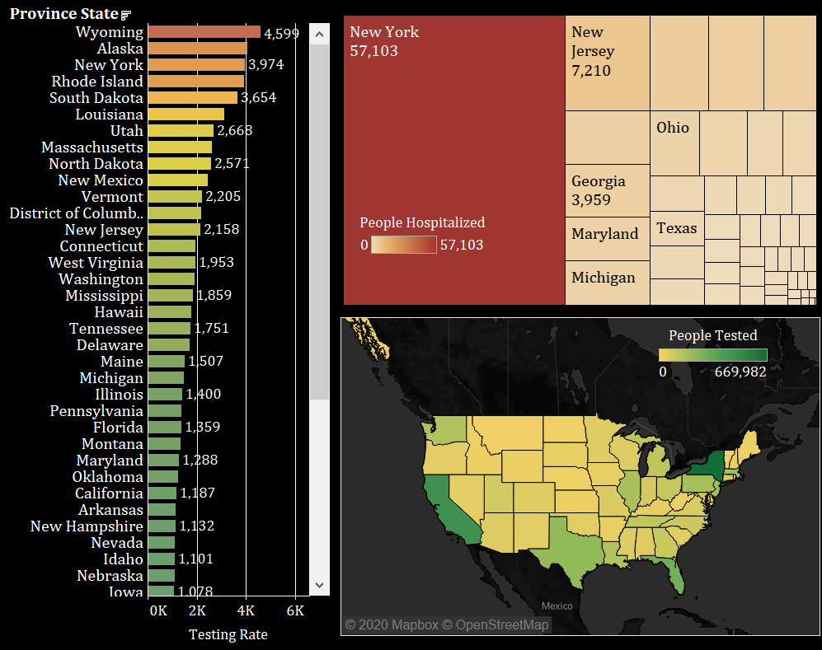

Slide 26
Summary
Provided analysis of COVID19 pandemic to determine any relationships or trends.
Followed shortened Agile framework for project schedule using checkpoints.
Built pipeline that streams COVID-19 and provides a visualization.
Selected GBM Multinomial model based AutoML recommendation leader using R-Squared, RMSE, and MSE.
Designed Tableau dashboard to display COVID-19 pandemic data.

Slide 27
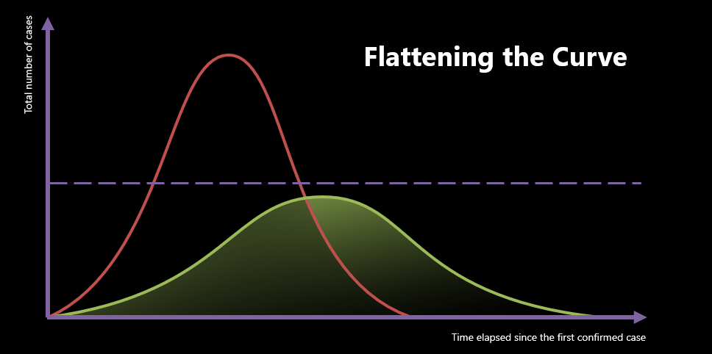
Any Questions or Comments?
Thank you

